Slide 1


Tha i grianach an-diugh.
Dè bhios sinn a’ dèanamh?
Notes:
It’s sunny today. What will we be doing?

Slide 2

Bidh sinn a’ dol dhan traigh.
Notes:
We will be going to the beach.

Slide 3

Tha i garbh an-diugh.
Dè bhios sinn a’ dèanamh?
Notes:
It’s windy today. What will we be doing?

Slide 4

Bidh sinn a’ cluich le itealag.
Notes:
We will be playing with a kite.

Slide 5

Tha i fliuch an-diugh.
Dè bhios sinn a’ dèanamh?
Notes:
It’s wet today. What will we be doing?

Slide 6
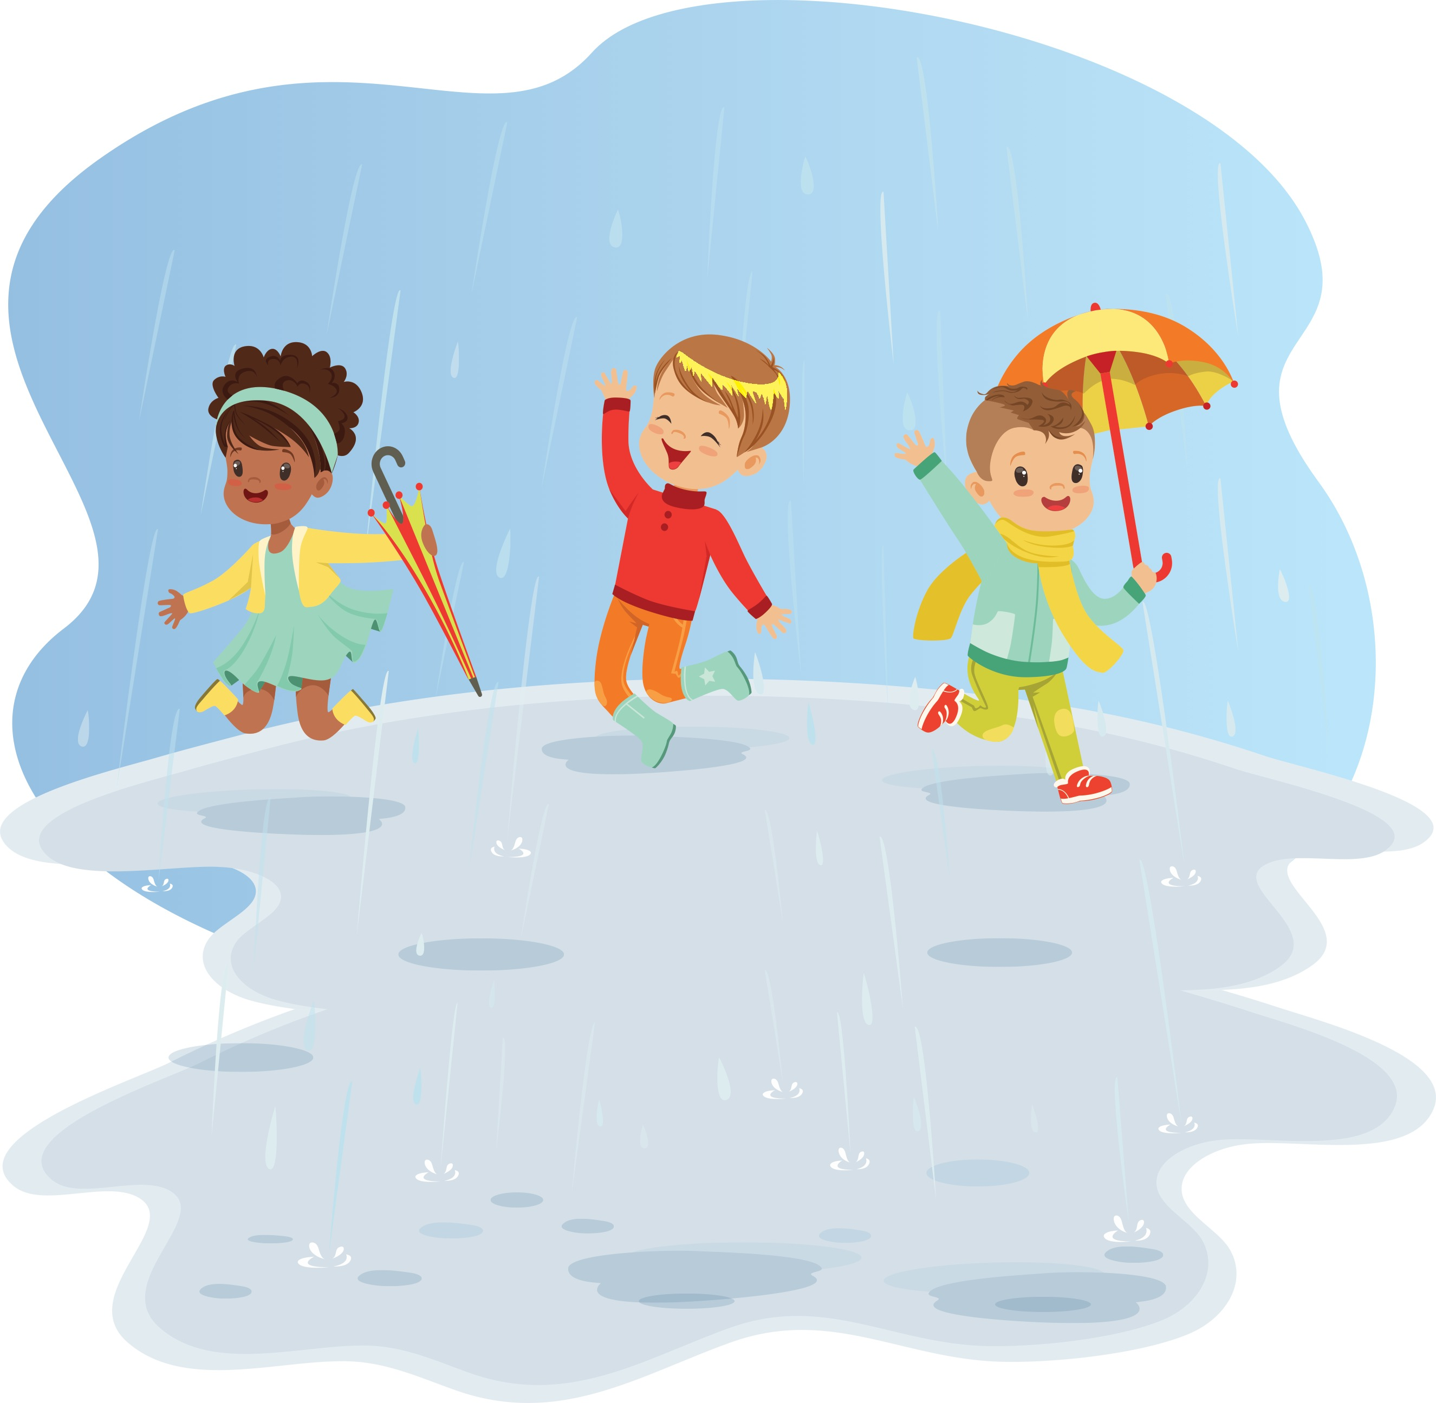
Bidh sinn a’ leum anns na lòintean.
Notes:
We will be jumping in the puddles.

Slide 7

Tha sneachda ann an-diugh.
Dè bhios sinn a’ dèanamh?
Notes:
There’s snow today. What will we be doing?

Slide 8

Bidh sinn a’ dèanamh bodach-sneachda.
Notes:
We will be building a snowman.

Slide 9
Tha i fuar an-diugh.
Dè bhios sinn a’ dèanamh?
Notes:
It’s cold today. What will we be doing?

Slide 10
Bidh sinn a’ fuireach a-staigh aig an teine.
Notes:
We will be staying inside at the fire.

